Slide 1


HealthCare Executive Group (HCEG)
Guiding Executives Through Innovation, Change and Growth, since 1988
30 Years at the Forefront of Healthcare Innovation and Technology
The HealthCare Executive Group (HCEG) is a national network of select healthcare executives, thought leaders and experts of various disciplines who’ve come together to navigate the tactical and strategic issues facing the healthcare industry today.
Notes:
Intro slide to HCEG and our 30 years

Slide 2



Leadership, Trust, and Skills in Overcoming Obstacles to Radical Innovation in Healthcare an HCEG Executive Leadership Roundtable
The HealthCare Executive Group is committed to providing a platform for real and relevant dialog amongst executives. Through our ongoing calendar of events including Executive Leadership Roundtables we are able to bring together our network of thought leaders for in depth discussions in a small group, boardroom-style setting, pertaining to one or more the the HCEG Top 10 Topics.
In Partnership with:
Notes:
Purpose of this slide is to present ELR discussion and partners

Slide 3
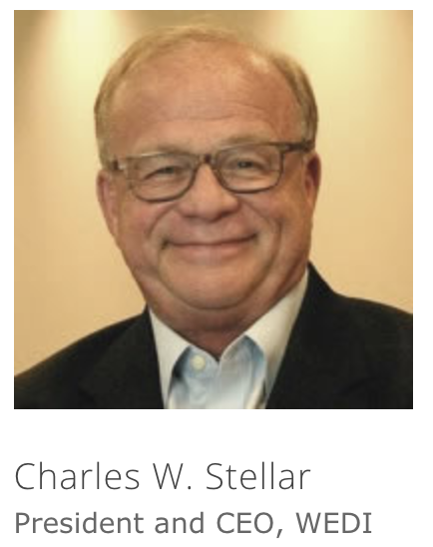
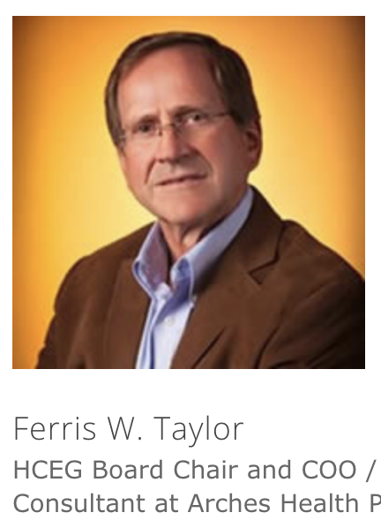
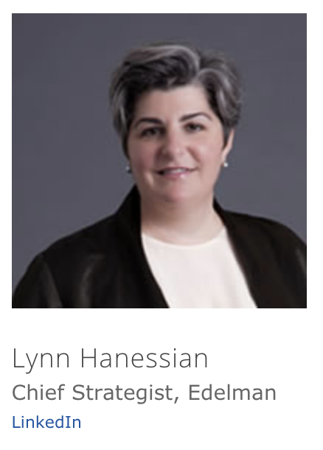
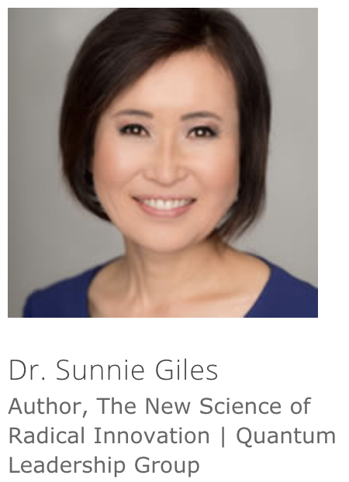

Today’s Presenters
Charles W. Stellar
President and CEO, WEDI
Former EVP, AHIP
Ferris W. Taylor
Executive Director, HCEG Former COO, Arches Health Plan
Lynn Hanessian
Chief Strategist, Edelmen
Board Member, CHI
Dr. Brett Trusko
President, International Association of Innovation Professionals (IAOIP)
Notes:
Purpose of this slide is to present panel

Slide 4
Today’s Discussion
Insights from Industry Pulse Research, Ferris Taylor
Implications of the Edelmen Trust Barometer, Lynn Hanessian
International Innovation Certification programs, Dr. Brett Trusko
The New Science of Radical innovation, Dr. Sunnie Giles
Notes:
Purpose of this slide is to present panel

Slide 5
HealthCare Executive Group (HCEG)
Guiding Executives Through Innovation, Change and Growth, since 1988
HCEG was founded in 1988 by healthcare executives looking for a forum that offered an open exchange of ideas, opportunities for collaboration and transformational dialogue. Each year, HCEG membership identifies the HCEG Top 10 opportunities, challenges and issues facing executives in healthcare. The HCEG Top 10 serve as the foundation for HCEG educational and programming initiatives throughout the year.

Slide 6

About HCEG
VISION
To be a professional network which is relevant, influential and sought after in healthcare, by promoting industry-wide transformation and innovations that foster market advancement and enables professional growth of its members.
OUR VALUES
Resources to support and enable a true “health care eco system” to reshape healthcare
Establishes life-long relationships that assist with current and future career advancement and development
Provides strategic development and mentored opportunities for member executives
Provides strategic advisory capabilities to CMS, AHIP and lobbying activities
Provides insights and knowledge to advance member organizations
Integrates health plan operations, IT and clinical issues to transform healthcare
Builds and strengths the IT and technology partnerships with health plan operations
MISSION
Thought leadership through the collective contributions of a select network of healthcare executives and industry experts, while building relationships that provide critical access to market knowledge, resources, and strategies.
Notes:
Don’t think we need this slide

Slide 7
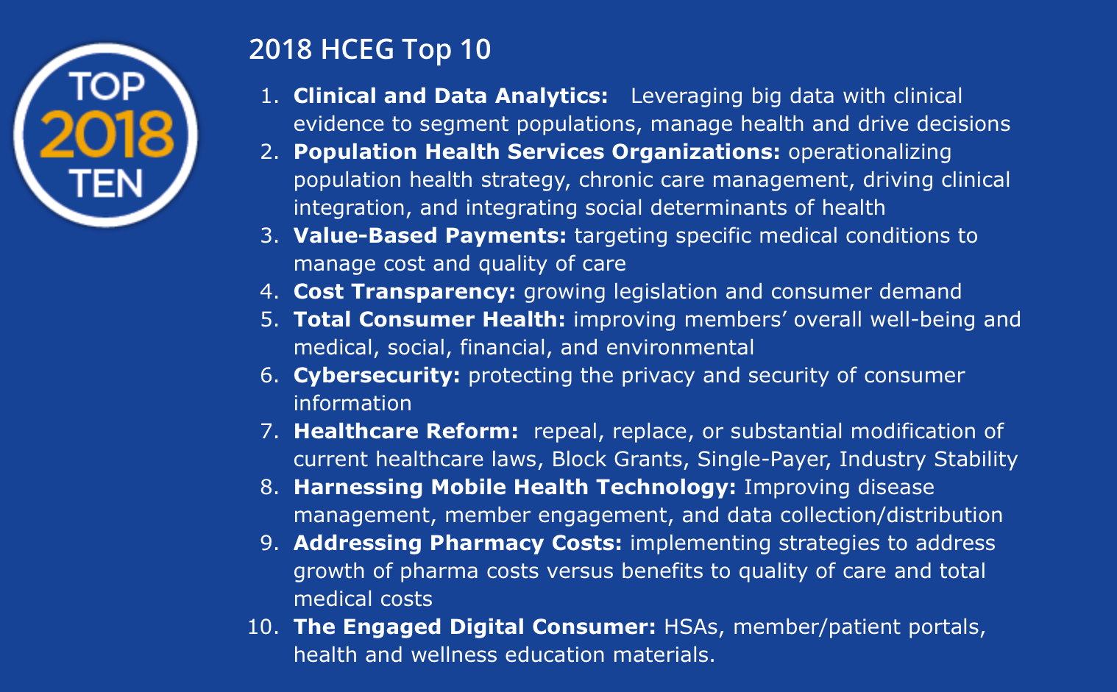

Slide 8
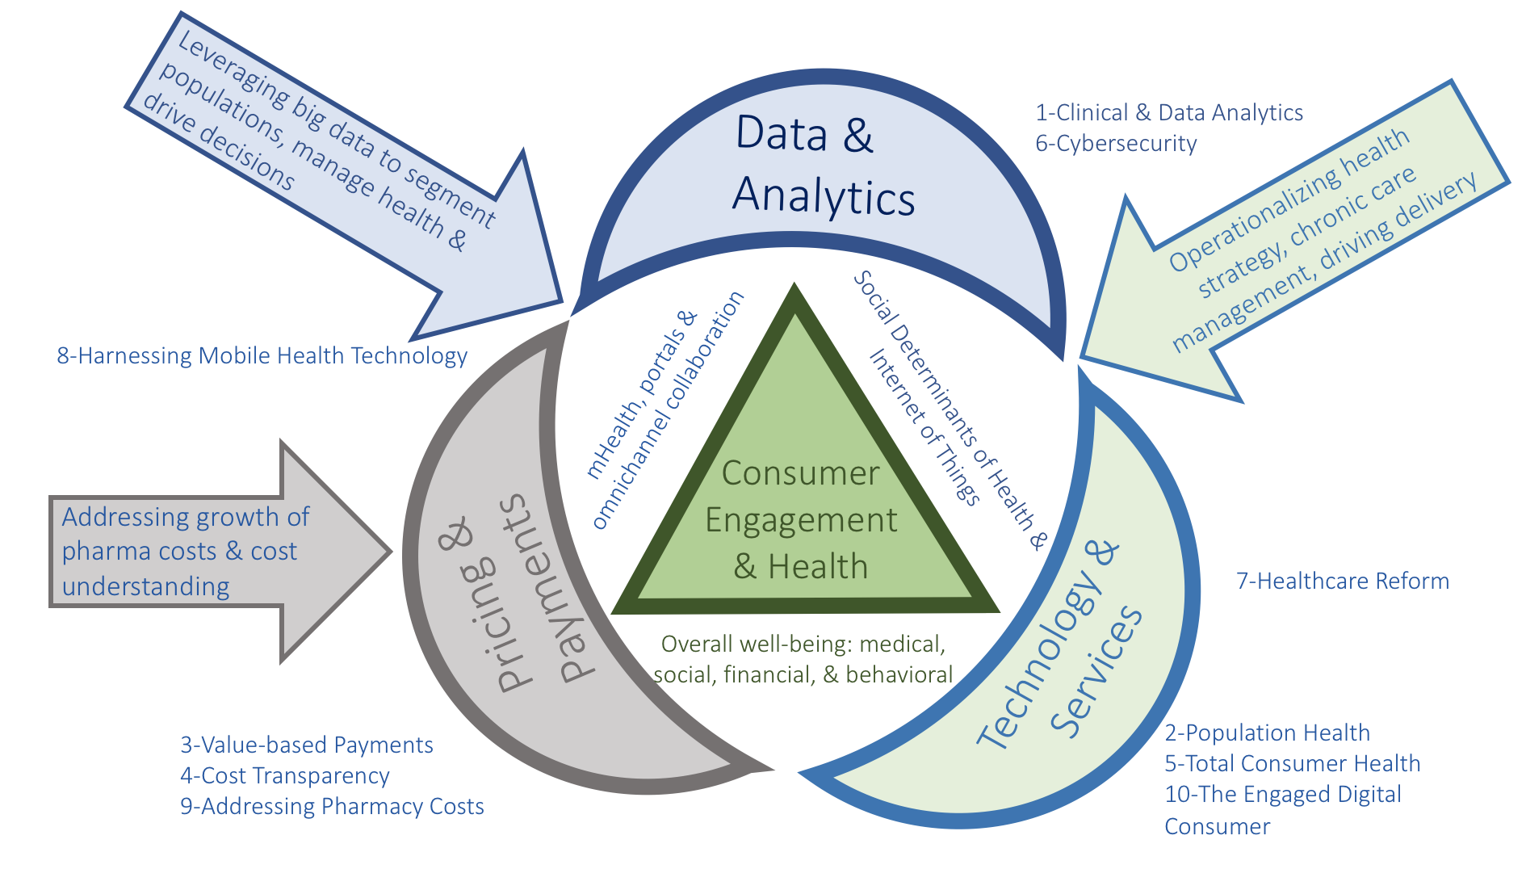
HCEG Top 10

Slide 9
Insights from Industry Pulse Research

Slide 10
About the Industry Pulse
A yearly HCEG industry research survey, in partnership with Change Healthcare, to gain insights from healthcare leaders across the country
GOAL
Gain insight on key trends and issues facing payers, providers, and the businesses that serve the healthcare market
TODAY’S ROUNDTABLE FOCUS
  Highlight where innovation in systems and technologies impact traditional Leadership Skills
  Note issues limiting consumer adoption digital technologies
  Share where research confirms “trust” issues in the marketplace
  Share HCEG Top 10 and Industry Pulse insights for addressing other issues and opportunities
PARTICIPATION
Data collection: Oct. 16 - Nov. 24, 2017
Healthcare leaders (n=121)
Questions received an average of 137 responses
OUTPUT
Analyze the data, share the results, and provide directional insight. The resulting report aims to provide valuable resources to help navigate the complexities of the rapidly evolving healthcare system.
The information and materials provided and referred to herein are not intended to constitute legal, regulatory, accounting, medical or financial advice and do not create an attorney-client or other fiduciary relationship between Change Healthcare or its representatives and any third party. Additionally, Change Healthcare does not guaranty the accuracy of the information contained herein. The interpretations, extrapolations, views and opinions of each individual presenter are not necessarily the views of Change Healthcare. Change Healthcare disclaims any and all liability for any reliance you may place on the information contained herein.
Notes:
Does this slide need to be included? Trying to keep to max 5 for Ferris’ portion of the presentation

Slide 11
Respondent demographics
n=181
n=117
Data collected Oct. 16 - Nov. 24, 2017

Slide 12
Insights from Industry Pulse Research
Social determinants of health transcended buzzword status
High-deductible health plans are not converting passive patients into active healthcare consumers.
Mobile/digital health adoption is not just about functionality and interoperability , but more about trust,
Industry attention has turned to blockchain, artificial intelligence, robotic process automation and other advanced technologies
Healthcare is transitioning from negative to positive incentives to influence consumer behavior faster than most expect
Notes:
The Industry Pulse survey focuses on payer organizations, but includes the perspectives of other industry stakeholders such as provider organizations and vendors. The survey is developed in partnership with the HealthCare Executive Group and is based on the HCEG Top Ten list compiled by HCEG members during their Annual Forum.
The research draws from more than 2,000 healthcare leaders, 52% VP and above, including Change Healthcare customers, HCEG members, and Health Plan Alliance members. The researchers targeted the leaders of these organizations, 27% of whom are at the president or C-suite level. The survey is designed to annually provide healthcare stakeholders with timely insight on opportunities, challenges, and trends in the healthcare market.

Slide 13
What has limited the widespread consumer adoption of mobile and digital health tools? (Select all that apply)
The balance between security and privacy issues with functionality and convenience will be an ongoing challenge for ”trust” among consumers, health plans, providers, and technology vendors
The need for a standardized health information exchange format continues to be a necessary building block
As an industry, we need to design products with consumers in mind, recognizing trust and medical literacy challenges
Other common responses:
Consumer limitations: ability and/or proclivity
to engage on mobile platforms
The complexity of selecting, implementing, and managing apps
Lack of a value proposition
n=158
Response Count: percentages will total over 100%

Slide 14
What do you feel is the impact of the following mobile health technologies on healthcare?
Diagnostic applications are poised to have a strong future, especially with the continued rise of telemedicine and improved regulatory clarity from the FDA on the development of consumer medical applications
Compared to 2016 responses, we saw positive gains across the board as digital technologies continue to have positive impacts on the industry
n=157

Slide 15
Historical data
2016 survey data: digital health technologies
Currently Impactful
Will be Impactful
Will not be Impactful
n=157

Slide 16
In your opinion what are the top three (3) primary barriers preventing the adoption of value-based reimbursement programs?
Several of the top barriers are psychological/trust issues, which require both payers and providers to think in new ways about care delivery and the business of healthcare
For VBR programs to be effective, there is a need for investments in new technology systems that can meet their data and analysis requirements
n=135

Slide 17
Which technologies are leading to significant administrative cost efficiencies? (Select all that apply)
Responses indicate that data integration is critical, with a safe assumption that it will be the foundation to realize greater benefits from the newer, up and coming technologies available
New to market technologies see a low response rate but we are likely to see a significant jump over the next few years
n=114
Response Count: percentages will total over 100%

Slide 18
Gains in effectiveness of clinical and data analytics
Percentage point change from 2016 to 2017
 | Not Effective / Slightly Effective | Moderately | Very Effective / Extremely Effective
Empower more productive providers | -13.69 | 4.14 | 9.55
Enable better engagement | -21.26 | 9.62 | 11.63
Enhance delivery system efficiency | -7.51 | 2.76 | 4.74
Improve integrated interactions | -16.27 | 3.25 | 13.02
Improve overall work flows | -13.39 | 0.60 | 12.79
Improve population health | -16.67 | 7.02 | 9.66
Reduce healthcare costs | -13.81 | -1.55 | 15.35

Slide 19
Year over year trends
Privacy and security, customer service, and clinical and data analytics continue to be identified as the most critical priorities for organizations as they move into 2018
2017 | 2016 | 2015 | 2014 | 2013 | 2012 | 2011 | 2010
Critical
Privacy & Security Customer Service Membership Retention Clinical & Data Analytics | Customer Service Privacy & Security Clinical & Data Analytics Risk Management | Customer service Data analytics Privacy & security Membership retention | Customer service Membership retention Membership growth Regulatory compliance Data analytics | Member retention Customer service Regulatory Compliance Membership Growth Provider Networking & Contracting | Member retention Member growth Customer service | Member retention Automation & performance optimization Member growth | Member retention Regulatory/ mandate compliance Health care reform compliance
Important
Regulatory/ Compliance Membership Growth Tech limitations & System integrations Risk Management | Member Retention Provider Network & Contracting Regulatory/ Compliance Payment Integrity Vendor Relationships | Vendor Relationships Brand & Marketing Product benefit design Provider Networking & contracting | Product benefit design Payment integrity Brand, marketing, communications | Private HIX Public HIX Risk Mgmt Payment Integrity | Claims accuracy and recovery Risk management Product benefit design | Regulatory/ mandate compliance Customer service Claims accuracy & recovery Product design | Automation & process optimization Product design
Lower Priority
Automation Payment integrity Provider network & contracting | Tech Limitations Branding, marketing & sales | Payment integrity | Risk mgmt. Privacy & security | Brand, marketing, & communications Product benefit design | Privacy & security New sales channels | Privacy and security Risk mgmt. | Customer Service Risk Mgmt. Claims accuracy and recovery

Slide 20
Trust in Health
2018 Edelman Trust Barometer

Slide 21

Trust Declines in 14 of 15 Sectors
Percent who trust each sector, and change from 2017 to 2018, in the U.S.
Distrust
Neutral
Trust
−
0
+
Y-to-Y Change
l | l | l | l | l | l | l | l | l | l | l | l | l | l | l
-9 | -9 | -10 | -2 | -13 | -4 | -2 | -4 | -10 | -8 | -6 | 0 | -1 | -4 | -1
Source: 2018 Edelman Trust Barometer. TRU_IND. Please indicate how much you trust businesses in each of the following industries to do what is right. Again, please use the same 9-point scale where one means that you “do not trust them at all” and nine means that you “trust them a great deal”. (Top 4 Box, Trust), industries shown to half of the sample. General Population, U.S.
21

Slide 22

Share Your Vision for Health Tech and its Benefits
Lead to better patient outcomes
    33
Empower
medical
professionals with
valuable information
    31
3. BEYOND THE TRANSACTION
Empower people with valuable information
    20
How is the application of technology to healthcare most likely to impact healthcare in the next 5 years?
    16
    9
    8
    7
Create new, unforeseen issues that we are not prepared to address
Provide me with information I may not want to have
Lead to worse outcomes to patients
Give too much information to healthcare professionals/ the healthcare system
Notes:
Our data also show the general population has generally positive sentiment toward the future of health technology.
While developing new treatments is expected of the Health industry, providing holistic solutions will further build trust.

Slide 23
Opinions Divided on the Impact of Tech to Cost of Healthcare
3. BEYOND THE TRANSACTION
23%
Will make healthcare MORE expensive
16%
Will make healthcare LESS expensive
How is the application of technology to healthcare most likely to impact healthcare in the next 5 years?
Notes:
Our data also found more people believe Health Tech will make healthcare more expensive.
Despite the positive outlook on Health Tech, companies will not be able to skirt the question of cost.

Slide 24
All Health Companies Must Address Cost,
Pharma Takes Bulk of Blame
4. LAB NOT SALES FORCE
0 out of 28 markets say Biotech most to blame
14 out of 28 markets say Pharma most to blame
Doctors and Middlemen tied in the U.S.
Pharma
Private Insurance Companies
Government Insurance Companies
Hospitals and Clinics
Doctors
Middlemen
Other
Biotech/Life Science
  I do not believe the cost of healthcare is that high
Most responsible
Least responsible
Notes:
Pharma was the most blamed in the U.S. for the cost of health, but this is an area all sub-sectors must address.
Rather than participating in the blame game, which we posit hurts trust in all associated with healthcare rather than clearing any one group from perceived wrongdoing, organizations may advance trust by showing that they are part of the solution.
This means addressing both unmet patient needs and the costs of care.

Slide 25
International Innovation Certification programs

Slide 26

International Association of Innovation Professionals (IAOIP)
Serious Innovation
The only innovation certifying body eligible for accreditation as a certifying body
The International Association of Innovation Professionals is a five year old certifying professional body dedicated to the advancement of innovation as a profession. We have five certification programs and are the US Secretariat to ISO 279 (Innovation Management). In this capacity, we are the certification to demand when hiring innovation professionals.
Notes:
Intro slide to HCEG and our 30 years

Slide 27

Our Mission
Professionalize Innovation
Develop communities of innovators worldwide
Develop K-12 programs to help teachers
Work with developing countries to help them innovate out of their problems
Create Special Interest Groups as a proxy for open innovation
Have a lot of fun . . . Serious fun!

Slide 28
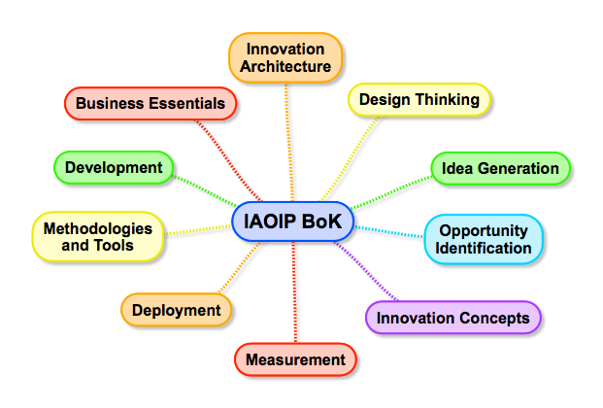
The Current Body of Best Practices

Slide 29
What if Fail Fast Isn’t an Option?
In today’s hyper-partisan world is failure and option?
  NASA
  Social Security
  Cybersecurity
  Medicine
  Critical Infrastructure
It may be in Silicon Valley, but not in most large organizations or the government.

Slide 30
Why Fail Fast Works in Tech
Failure is cheap!
Fail Fast
Blockbuster
Innovation
Sweet
Spot
Innovation Continuum

Slide 31
Why We Started the Organization
Fail Fast
Why fail at all?
Failure good?

Slide 32





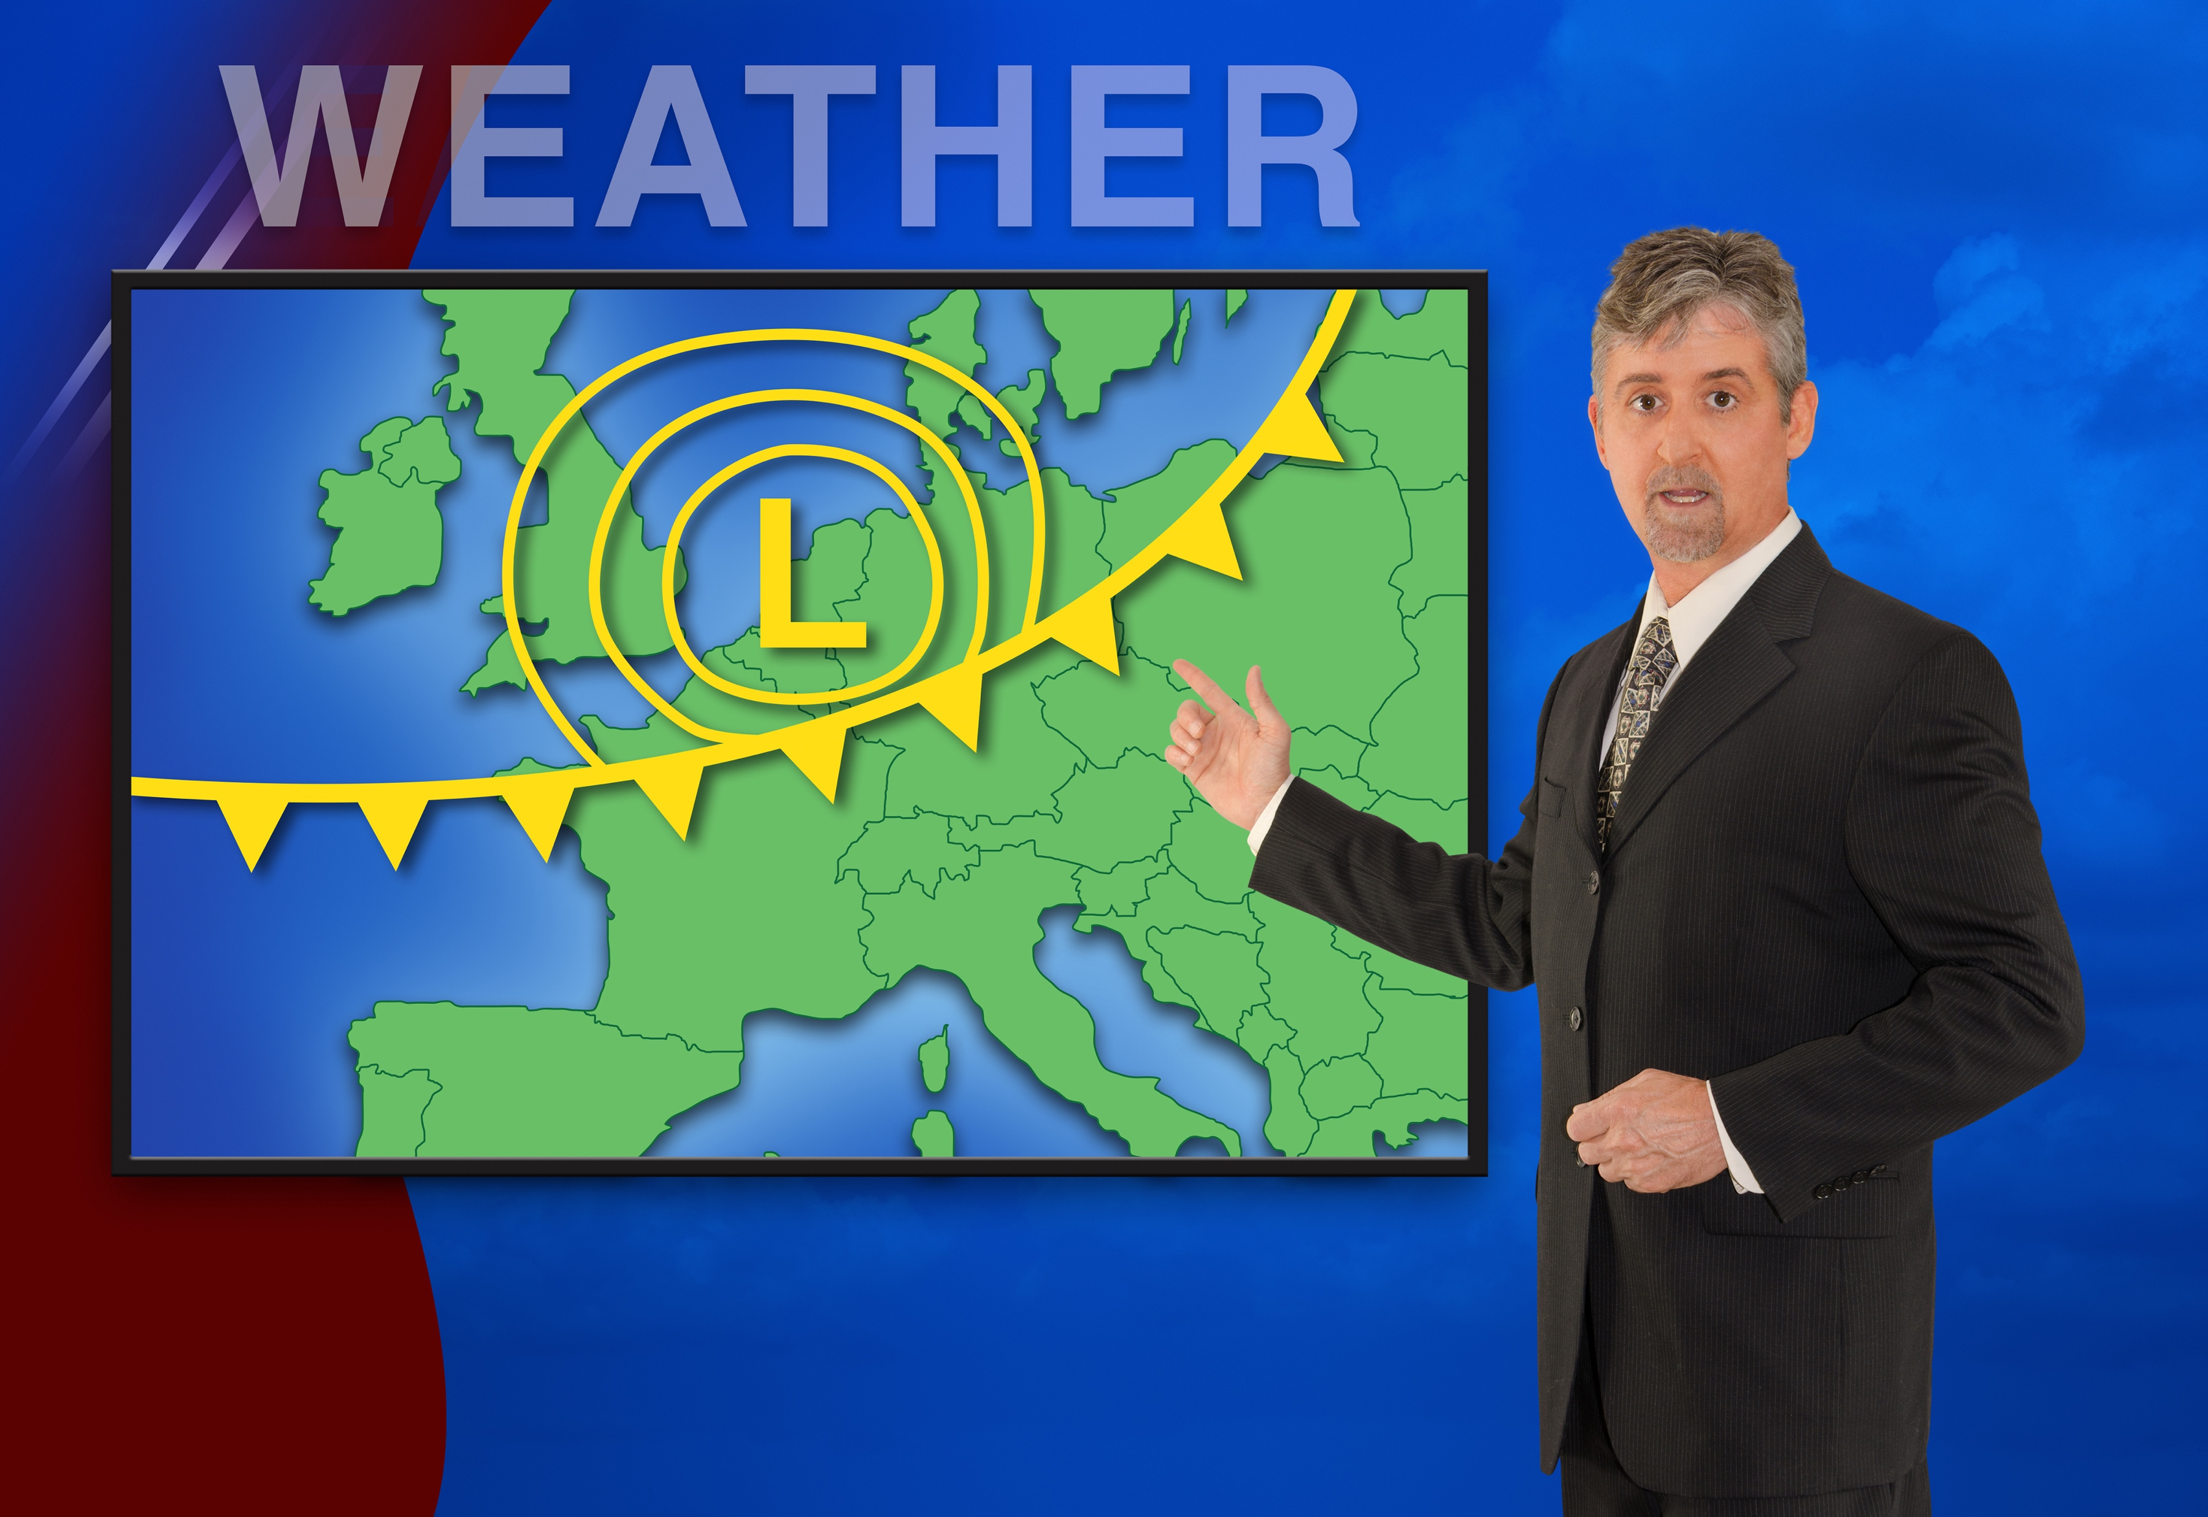
Why is Professionalization Important?
Notes:
Medicine Man to physician
Oracle to Strategist
Rain Maker to Weatherman

Slide 33

The Common Thread is Science
Notes:
Can’t manage what you can’t measure
Creativity on it’s own isn’t measureble

Slide 34
Innovation Dissected
Business Science:
Entrepreneurship,
Management, Operations, Project Management
Humanity/Social Sciences:
Creativity, Ethnography, Human Focused Design, Leadership
Problem Solving Sciences:
Math, Engineering, Physics, Chemistry, Life Sciences
Notes:
Can’t manage what you can’t measure
Creativity on it’s own isn’t measureble

Slide 35
Innovation Dissected
Innovation Dissected
New business offerings, services, non-profit growth
Business Science:
Humanity/Social Sciences:
New business models, unexpected delightful products/services
Improved
products/services,
fix problems, optimization
Enhanced products/services,
Unexpected features,
pleasing products
Problem Solving Sciences:
Notes:
Can’t manage what you can’t measure
Creativity on it’s own isn’t measureble

Slide 36



What Most People Don’t Understand About Innovation
Ideas
Innovator
Entrepreneur
Notes:
Lot’s of people have ideas – great ideas
Entrepreneurs are not necessarily creative
Innovation put sthe two together

Slide 37
What You Can Do Now
The United States has very low participation in ISO – Please consider joining the delegation and representing your country.
The Innovation Body of Knowledge (IBOK) is still in development. Join to be a part of the discussion.
The Healthcare Special Interest Group needs leadership.
Request certification when hiring innovation professionals.
Support our efforts through individual or corporate membership.

Slide 38
Thank You
Contact:
Brett Trusko, PhD
President and CEO
Secretariat, US Delegation, ISO 279 – Innovation Management
The International Association of Innovation Professionals
http://www.iaoip.org
brett@iaoip.org

Slide 39
The New Science of Radical innovation

Slide 40


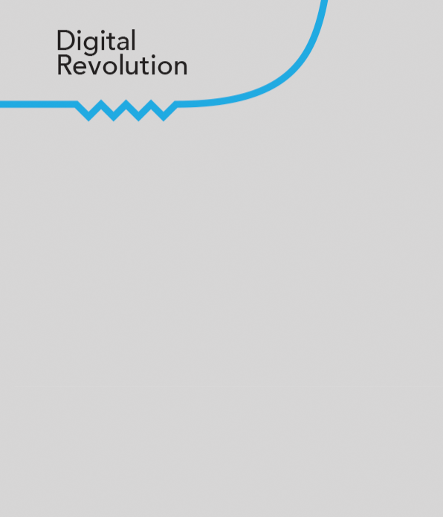





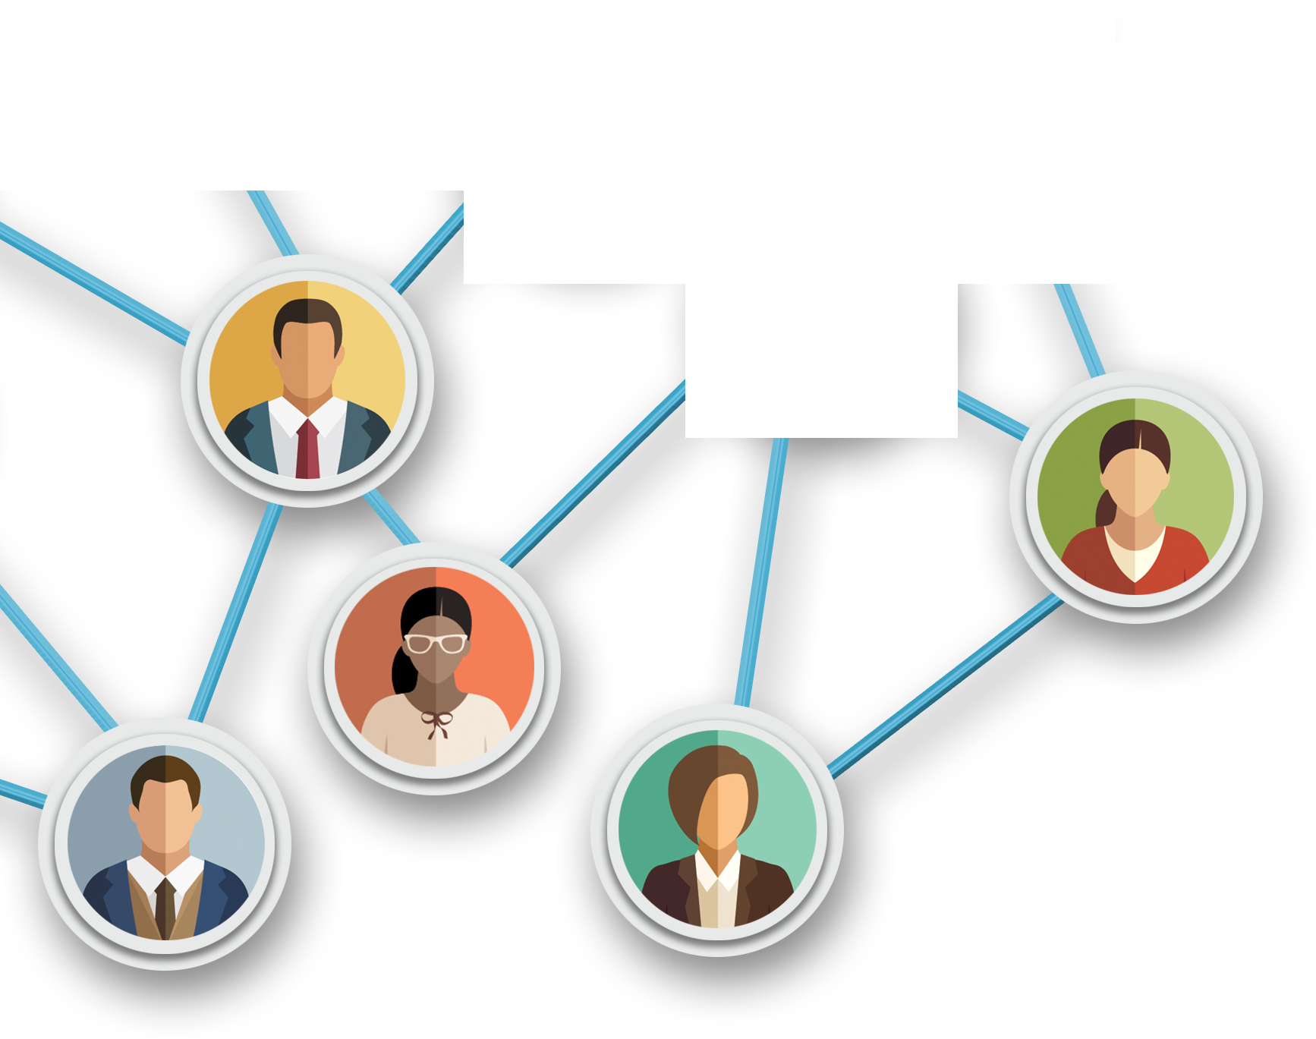
Three Major Revolutions
Type of System
Simple
Complicated
Complex
Type of
Leadership
Paternalistic Autocractic
Command and control
Quantum Leadership: flexibility, openness, speed
Capital Preservation and Expansion
Efficiency and Standardization
Learning and Innovation
Basis of Competition
Organizational Structure
One-to-One
One to many
Many-to-many
Notes:
One to one:

Slide 41





4 Factors That Make It Challenging for Leaders
Volatility, Uncertainty, Complexity & Ambiguity (VUCA)
Increased speed
Increased interdependence
Increased density of interactions
Increased variety of input
V
U
C
A
VUCA can be your problem or your solution
Notes:
DISCUSS QUESTIONS:
Can you identify any self-organizing principles being implemented at your company?
What do you think would be the barriers company’s might face in adopting self-organization?
What are some other ways self-organizing can be used in companies?
ADDITIONAL EXAMPLE IF NEEDED:
Google
- Hire the best people and get out of their way
- Allow people to self-organize
- Managers are encouraged to delegate as much as possible
- Google’s 20 percent–time policy: employees spend 20 % of their time working on what they think will most benefit the company
Empowers motivation

Slide 42










How Does Radical Innovation Come About?
Radical innovation is a serendipitous result of many self-organizing, interdependent employees, who learn from profuse experiments and use simple rules.
Notes:
SAY:
Radical innovation is a serendipitous result of many self-organizing, interdependent employees, who learn from profuse experiments and use simple rules.
Remember how the PROCESS OF COMPLEXITY was defined: “The holistic, unpredictable result of many self-organizing, interdependent agents learning by profuse trial-and-error experiments following simple rules.”

Slide 43

Radical Innovation
Flows out of a serendipitous divergent reconstitution of existing models, processes, and products
Not created from scratch
Not planned or choreographed
A result of accumulated errors crossing the inflection point: mutation’s role in earth’s history
Requires speed, connection, diverse input and dense networks

Slide 44

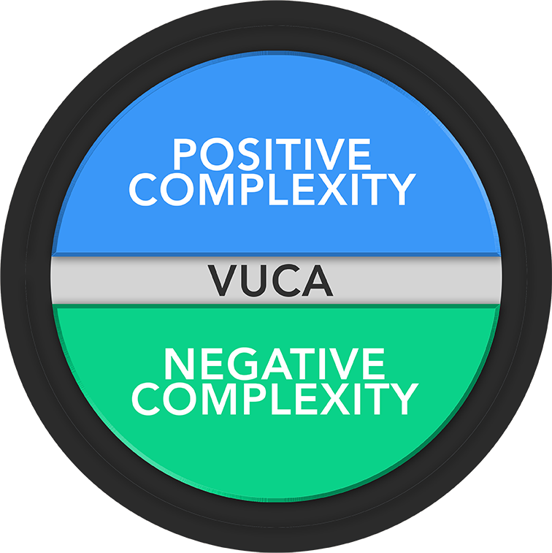
Negative and Positive Complexity (VUCA)
What makes complexity?: increases speed, interdependence, variety of variables, and density of interactions
Negative complexity: challenging for leaders
Positive complexity: necessary for radical innovation
The underlying dynamics are the same! Don’t fear complexity; harness it.
+
-
Notes:
TRANSITION: “Here’s an example…”

Slide 45
Fundamental Rule: How to Harness VUCA
Increase:
  Speed: transparency, self-organization, recoupling of information, responsibility & authority, simple rules
  Interdependence: connection among teams and with the ecosystem
  Diversity: generalist approach, crowd sourcing, psychological safety; not a compliance issue
  Density of interaction: open workspace
V
U
C
A
Copyright Quantum Leadership Group, 2017: www.sunniegiles.com
Notes:
Use Self-organizing agents:

Slide 46
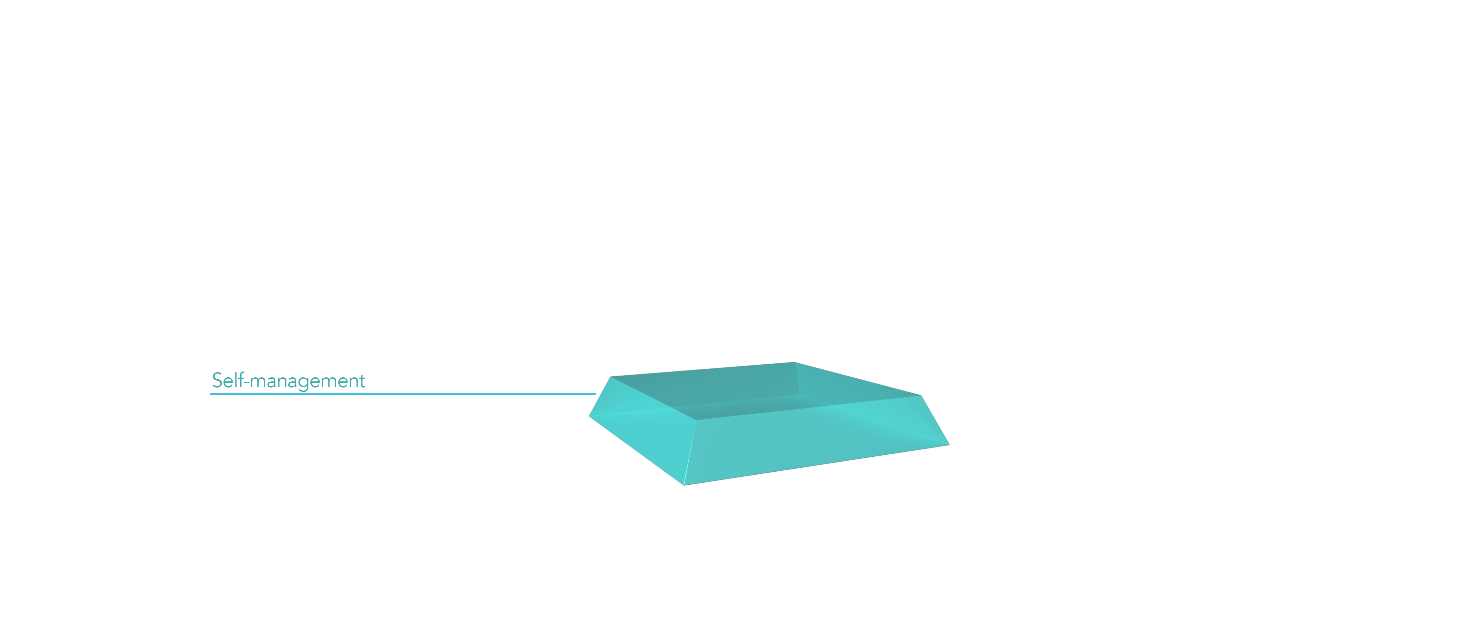
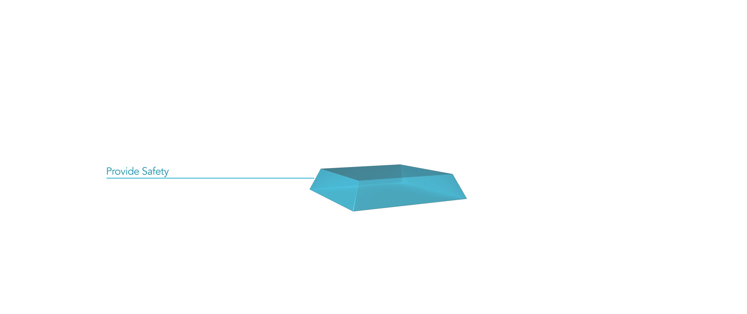




How to Harness VUCA through the 6 competencies
The 6 Leadership competencies: to maximize your chances for radical innovation through leadership and culture
Notes:
REFER TO THE PARTICIPANT GUIDE:
These are competencies required to win in a complex world by creating more value faster than competition.
Self-management (decision making based on self awareness)
Providing safety (Fundamental need. Safety is foundation of Maslow’s Hierarchy of Needs)
Creating differentiation (The process of producing variation, separate and distinct from others and from the environment)
Strengthening connection (When two or more minds with differentiated perspectives meet, synergy is created with much greater and better output than they can create on their own)
Facilitating learning and adapting (Self Explanatory)
Stimulating radical innovation (Self Explanatory)

Slide 47


Radical Innovation, the book + 3-day Innovation Training
On Amazon
Bulk purchase: a lunch and learn discussion
Three-day workshop
sunnie@sunniegiles.com
Copyright Quantum Leadership Group, 2017: www.sunniegiles.com

Slide 48

Join HCEG Annual Forum to Celebrate 30 Years
Keynotes:
Andy Slavitt – Former CMS Administrator & Board Chair of the United States of Care
Dan Buettner – Explorer, National Geographic Fellow and New York Times Best Selling Author of “The Blue Zones: 9 Lessons for Living Longer
National Healthcare Thought Leaders
Email Juliana Ruiz jr@hceg.org about HCEG & to join us Minneapolis

Slide 49
Thank You
Connect with us:
HealthCare Executive Group
@HCExecGroup
HealthCare Executive Group

